Slide 1
BBB

Slide 2
Inhoudsopgave
Intro
Maths
Model
Analysis
Phase-transistion &Bose-einstein

Slide 3
Project aim – research questions
Research question: How does the degree distribution in the Bianconi-Barabasi model depend on the fitness distribution in the network? Simultaneously, can we find the fitness distribution of real-world networks based on the time evolution of the degree of the nodes? Finally, can we observe the phase transition where a finite fraction of the nodes is linked to a single node?

Slide 4

Hypothesis
Hypotheses: The degree distribution will follow a power-law, precisely like the BA model, if the fitness distribution has a finite domain. The node with the highest fitness value will draw a lot of other nodes in the second instance if the fitness distribution has an unlimited domain, resulting in a situation winner takes all phenomenon. We will therefor find in the plots a powerlaw disitbution with the exponent comparable to __ (from analysis).
It is possible to recreate the fitness distribution based on the degree distribution of real-networks that were created in a Biaconni-Barabasi fashion.

Slide 5
Maths

Slide 6
Bianconi-Barabasi Networks
What is it?
Preferential attachment
Fitness
Phase transitions
Maths

Slide 7
Basics of the Bianconi-Barabasi Networks
Added feature: Fitness
Preferential attachment based on that fitness
New emergence behaviours:
Winner-takes-all phenomenon vs. Richer-get-richer

Slide 8

Preferential attachment
Add nodes with preferential attachment:
$Π_{i}=\frac{η_{i}k_{i}}{\sum_{j}{η_{j}k_{j}}}$

Slide 9
Fitness
What is fitness?
Fitness is unchanged once assigned
Drawn from distribution
Research question: How does it affect the degree distribution

Slide 10
Network analysis
Test network for
Small work properties
Node overtaking
Robustness against attacks
 | Delta | Uniform (BA-network) | Exponential
AVG pathlength | 4.9683 | 3.9989890589058907 | 3.5664446444644464
Average clustering coefficient | 0.006047566041299551 | 0.050353760574029974 | 0.06587064242944182
Hubs | 2,1,3,6,3 | 0,20,38,3,27 | 237,72,279,144,29
Connected components before attack | 1 | 1 | 1
Connected components after attack | 15 | 169 | 1239

Slide 11
Effect of fitness distribution on degree distribution
* graphs from Aarons notebook

Slide 12
Power law?
Power law vs. other distribution:
Conclusions
 | lognormal | exponential | Lognormal positive | Truncated power law | Stretched exponential
Delta | R = , p= | R = , p= | R = , p= | R = , p= | R = , p=
Uniform | R = , p= | R = , p= | R = , p= | R = , p= | R = , p=
Exponential | R = , p= | R = , p= | R = , p= | R = , p= | R = , p=

Slide 13
Real data

Slide 14
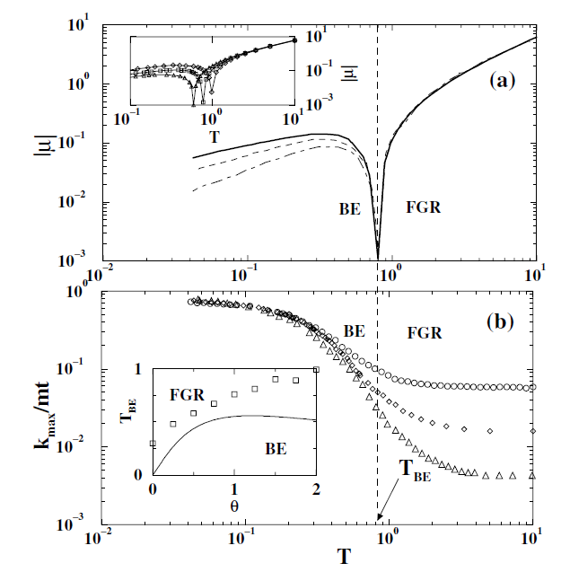
Phase transition

Slide 15
Conclusions

Slide 16
Questions

